Slide 1


Color-Selected AGN in the JWST North Ecliptic Pole Time-Domain Field
Cameron White
Arizona State University
13 April 2019

Slide 2
Time-Domain Science:
How do astronomical objects change with time?
Type Ia supernovae variability
Active galactic nuclei (AGN) variability
Brown dwarf variability
Oort Cloud and Kuiper Belt proper motions
Endless possibilities!

Slide 3
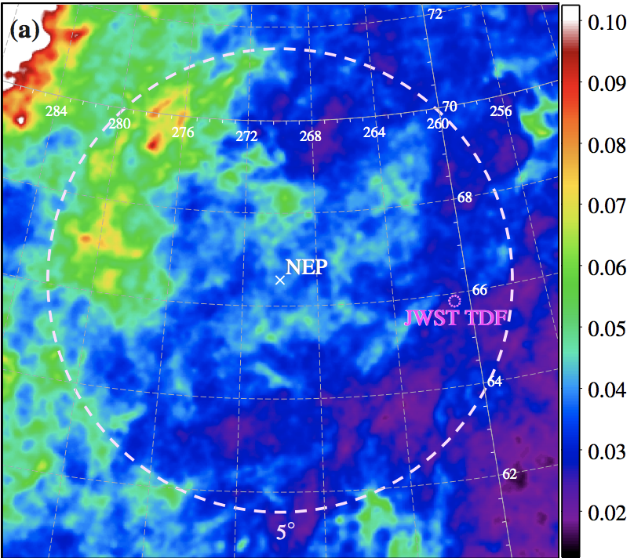
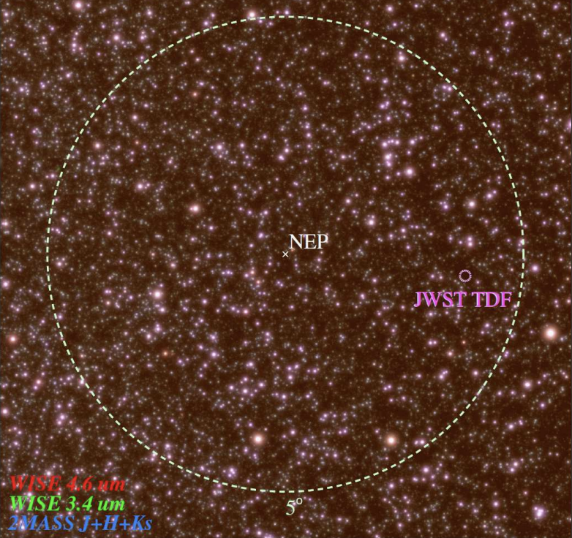
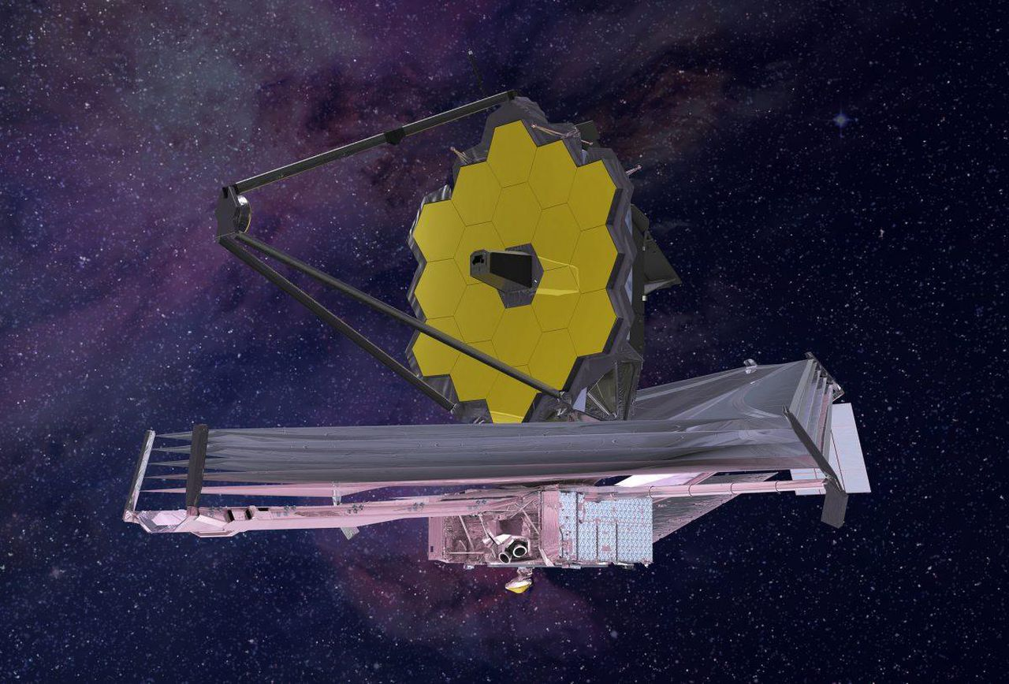
Selecting the best field for time-domain science with James Webb
Primary requirements:
Continuously observable
Minimal bright IR sources
Low galactic dust extinction

Slide 4
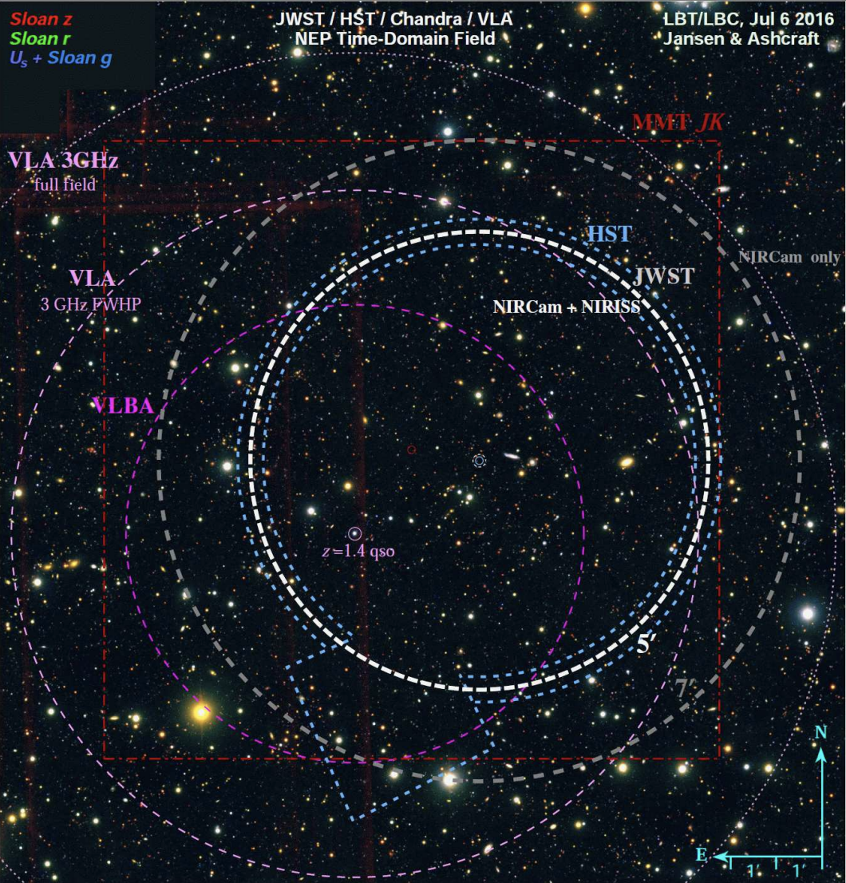
The James Webb Space Telescope North Ecliptic Pole Time-Domain Field (JWST NEP TDF):
The best field for a deep extragalactic time-domain survey with JWST!

Slide 5
Past, ongoing, and approved observations of the JWST NEP TDF
X-Ray: Chandra (900 ks)
UV: Hubble Space Telescope (HST)
Optical: HST, LBT, Subaru
NIR/IR/FIR: MMT, JWST, JCMT
Microwave: IRAM
Radio: VLA, VLBA, LOFAR

Slide 6
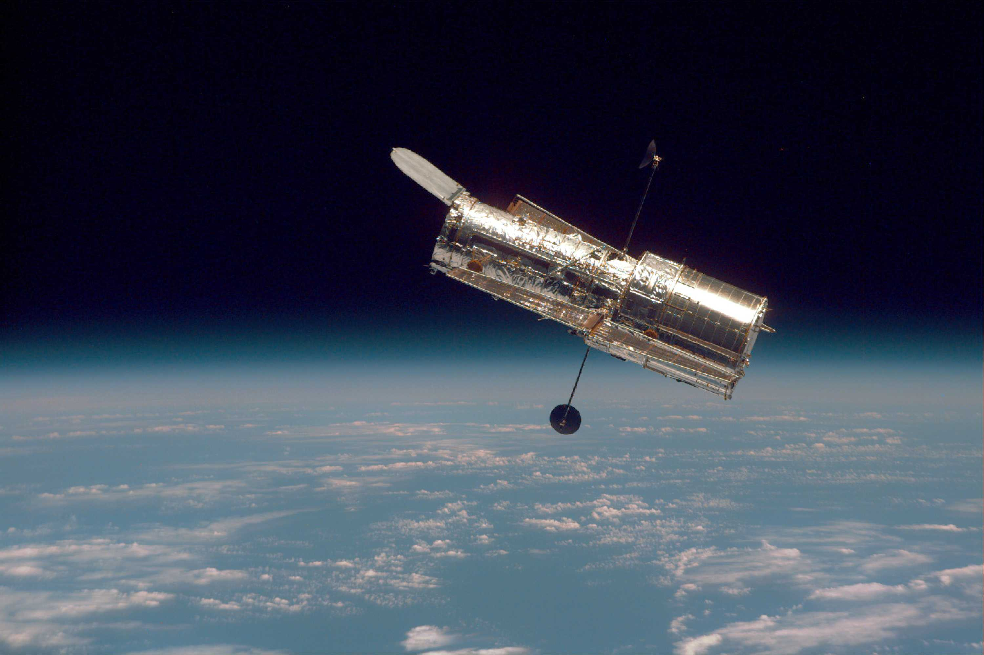
Hubble Space Telescope Observations
Three filters:
  F275W (near-UV, 275 nm)
  F435W (B-band, 435 nm)
  F606W (V-band, 606 nm)
Goals:
  Generate photometry catalogs
  Color-select AGN candidates
  Identify variability in overlapping epochs

Slide 7
HST Photometry and number counts

Slide 8
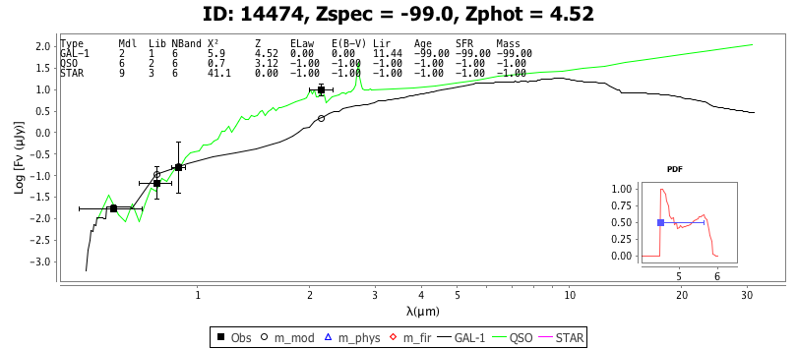
SED-Fitting

Slide 9
Conclusions
The JWST NEP TDF is the best field for deep extragalactic time-domain science with JWST
Multi-wavelength coverage will demonstrate field’s potential as a community field for time-domain science
New ground- and space-based photometry allows for first science with JWST NEP TDF such as AGN selections
Questions?

